Slide 1
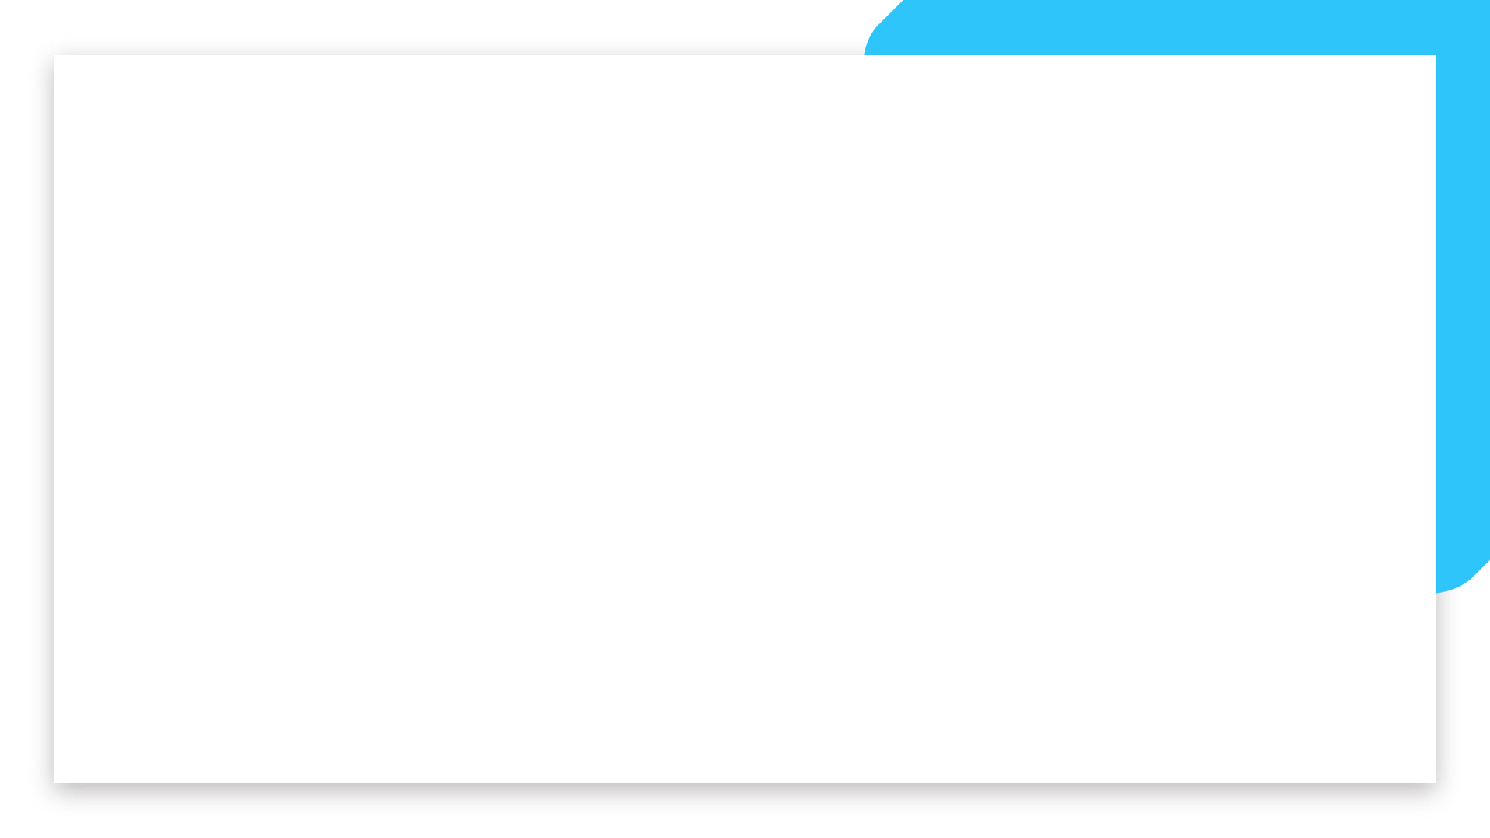


Data Analytics
Full-Time Bootcamp
INTRO TO TIME SERIES FORECASTING

Slide 2
TIME SERIES - WHAT ARE THESE?
A time series is a set indexed by another, fully ordered set 😶...
With this useful definition out of the way, what is a time series for us here?
We will make it even simpler and say that a time series is a numeric variable that we can represent in a Pandas Series where the index is a datetime object.
"Sequence of points measuring the same thing over time" Some Blog
"Series of numeric values, each paired with a timestamp defined by a name and a set of labelled dimensions" Some Blog
"Data that collectively represents how a system/process/behaviour changes over time" Again, Some Blog
Go to collab 1

Slide 3
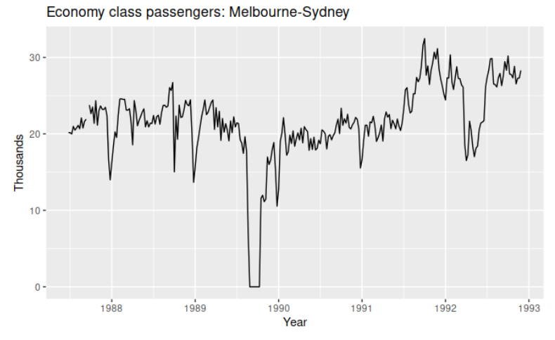
TIME SERIES - GREAT FOR PLOTS!
Time series are often represented in time line plots that allows us to spot intuitively how terrible our job is going to be
In this chart, for example, we can see the following effects:
There was a period in 1989 when no passengers were carried due to a strike.
There was a period of reduced load in 1992 due to a trial in which some economy class seats were replaced by business class seats.
A large increase in passenger load occurred in the second half of 1991.
There are some large dips in load around the start of each year. These are due to holiday effects.

Slide 4
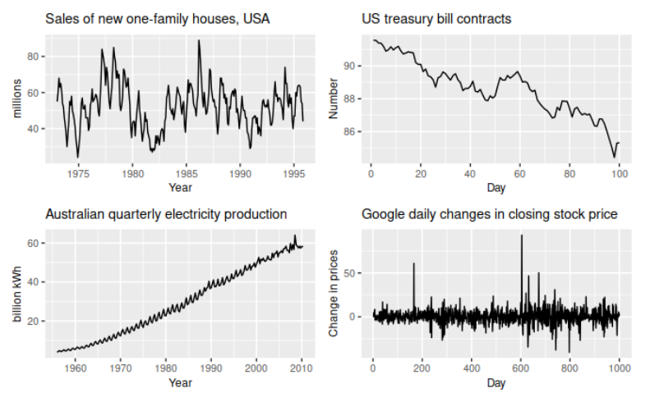
TIME SERIES - PATTERNS
Let’s look at these charts and try to see some patterns
Components of time series
Trend Component
Seasonality Component
Cyclical Component
Irregular Component

Slide 5
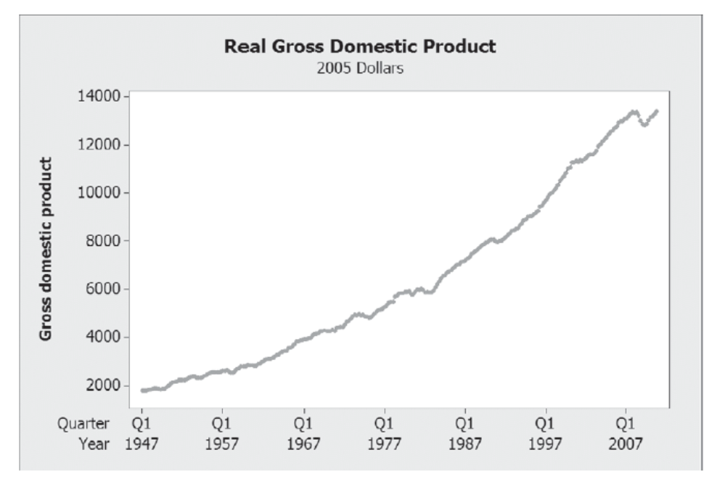
TIME SERIES - TREND
Long Term Underlying Component
Usually modelled with a simple function/model with a regression, could be linear, quadratic etc.
"Macro" models are developed to intuitively describe the trending component

Slide 6
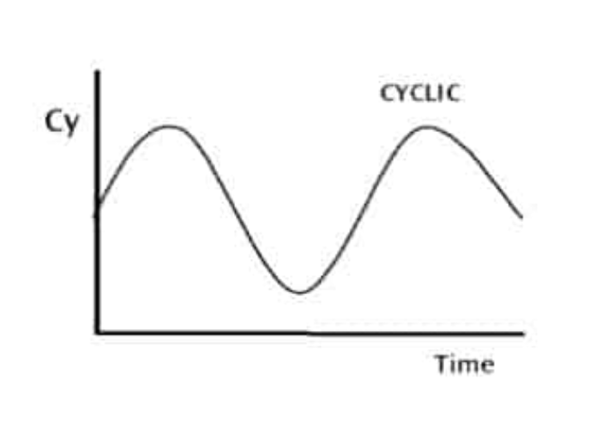
TIME SERIES - CYCLICAL
Certain phenomena go through cycles with a repetitive behaviour
Not necessarily with a regular time interval or reason (economy for example)

Slide 7
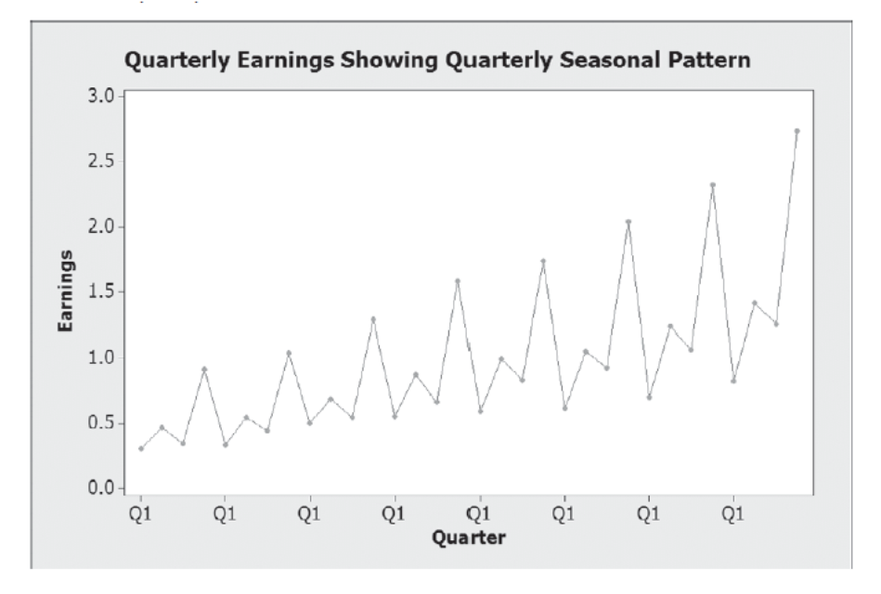
TIME SERIES - SEASONAL
Repetitive behaviour with well known time period
Reasons for seasonal behaviour are usually well identified and repeatable
Corporate calendar, summer/winter, school calendar etc.
Python can do some magic for us here… Go to collab 2

Slide 8

TIME SERIES FORECASTING - AUTOREGRESSIVE MODELS
We have seen linear models, where we predict a response variable from a linear combination of independent ones
When working with time series data, our response variable depends not only on the predictor variables but also on the response variable itself. A variable that depends on itself is called an autocorrelated variable and we can consider autoregressive models like the one below
Go to collab 3

Slide 9
TIME SERIES FORECASTING - AUTOREGRESSIVE MODELS
Purely autoregressive models have a serious tendency to “run away”
Once we forecast too much into the future we have a divergent solution (forecast either increases forever or decreases forever)
There are several ways to address this, but the one idea we are going to explore is the Moving Average logic

Slide 10
TIME SERIES FORECASTING - MOVING AVERAGE
“Let’s call this method something that already exists and is widely accepted in the same field”
Some douchebag, XIX century
A MOVING AVERAGE MODEL DOES NOT CONSIST IN TAKING A MOVING AVERAGE FOR SMOOTHING
An MA model is one that, instead of looking at the last prediction it made, looks at **the error* of the last prediction it made to make the next forecast. This of course require us to know the real value of the last observation so we are now talking about "one step ahead" forecasting. Moving average models by themselves are not that useful but combined with an autoregressive component they are actually quite powerful.
I
Go to collab 4

Slide 11
TIME SERIES FORECASTING - WHAT NEXT
ARIMA - Adding some terms to handle increases or decreases of variance in some parts of the TS
Multiple Variables - Does CO2 and temperature have an influence on each other, for example
Separate shocks and trends - TS are good for trends, for shocks you should use other techniques
Non-linear models - AR models don’t need to be linear
LSTMs - AR logic taken to the extreme with deep learning

Slide 12
REFERENCES
https://otexts.com/fpp2/
https://towardsdatascience.com/an-overview-of-time-series-forecasting-models-a2fa7a358fcb
Newbold, Carlson, Thorne, Statistics for Business and Economics

